Slide 1
DROWSINESS DETECTION AND
ALERT SYSTEM
Image Processing
UNDER THE GUIDANCE OF swathi JN madam
TEAM MEMBERS :
1)18BCE0242 - MALLENI SAI PRANEETH
1) 18BCE0365 - LAGUMSANI CHARAN
3) 18BCI0106 -D HEMANTH

Slide 2
INTRODUCTION
Drowsiness is a condition which diminishes the awareness caused by the absence of rest or weariness. Due to weariness,driver lose their control which may divert them from the street and prompts serious mishaps.
Basically, these mishaps happen because of the driver’s tired condition. Therefore , a model is required to keep the driver in engaged state.
The goal of our model is to make a driver weariness location which demonstrates driver’s lethargic condition through their face.
The strategy is to distinguish the drivers state by utilizing face detection,primarily focuses on the edges of the face through which the weakness condition is obtained be it tiredness, stress,consumption of alcohol or using mobile .

Slide 3
Objectives
Most of the road accidents are due to driver’s fatigue, distraction and drowsiness. Various new creative technologies are introduced to avoid and reduce these accidents.
This system can reduce the road related accidents due to drowsiness. The drivers face will be detected, focusing on the edges of the face through which the weakness condition is obtained tiredness, stress, consumption of alcohol, etc.
The eye is monitored by the webcam and the data is sent and processed and the signal is sent to the alarm system.

Slide 4
LITERATURE SURVEY
The ﬁrst approach was to study the physciological features such as brain wave(EEG wave),heart rate.Later they used ORD model which accounts the physical appearance,behaviour,mannerisms.Recently came the HMM and SVM. HMM uses the observations to get the states. It can be used for time series classiﬁcation if the given time series data is an output of a state machine system. HMM is a powerful modeling technique when the system states are partially observable and the behavior of the system is considered as autonomous.

Slide 5
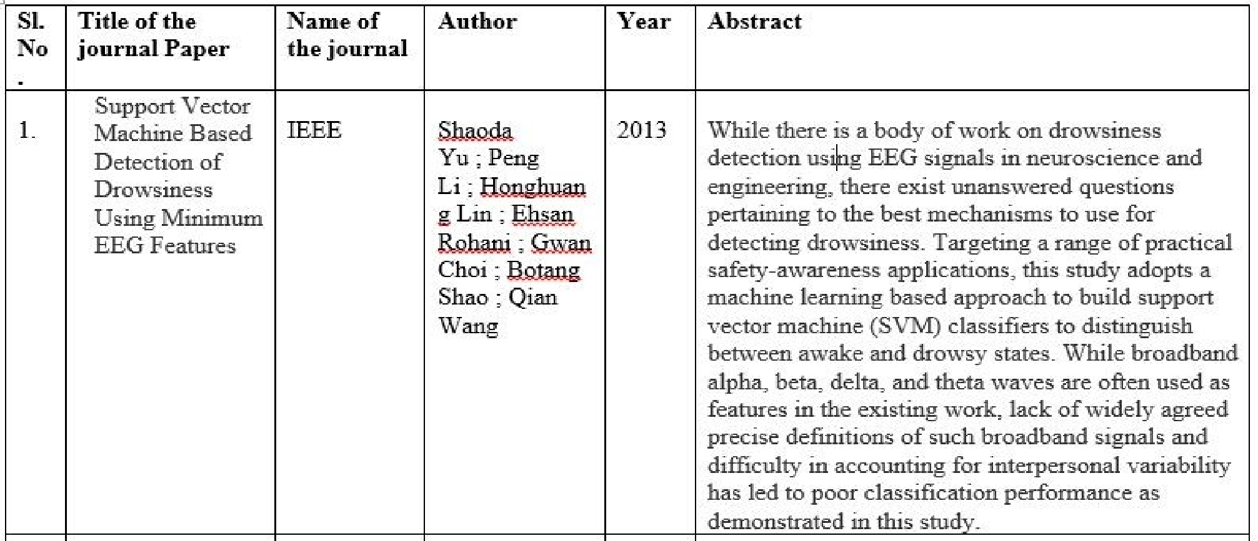

Slide 6
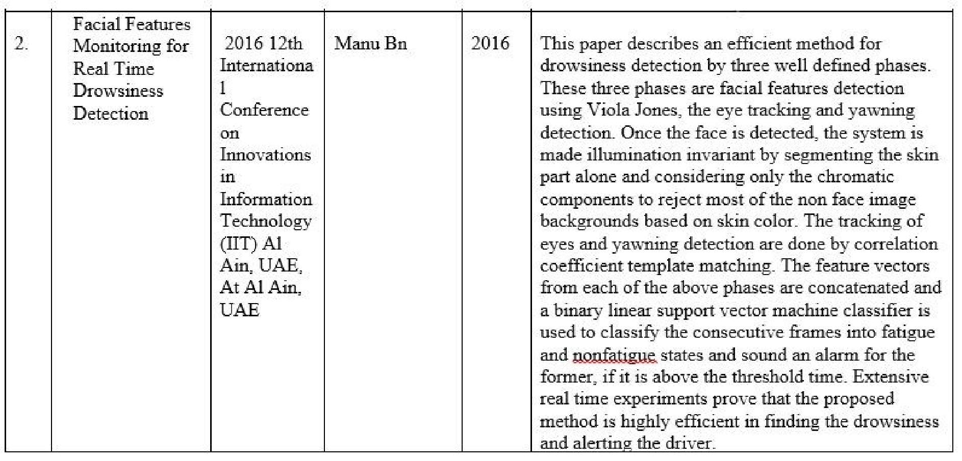

Slide 7
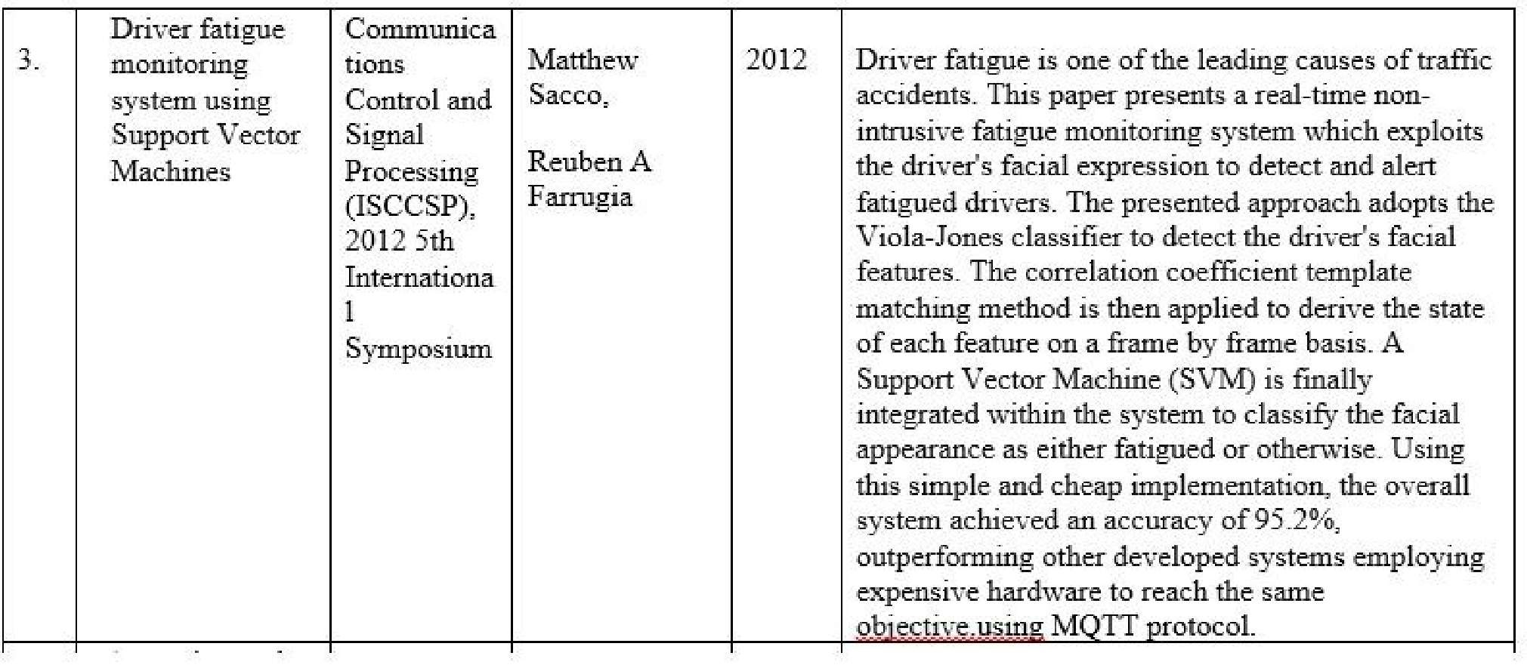

Slide 8
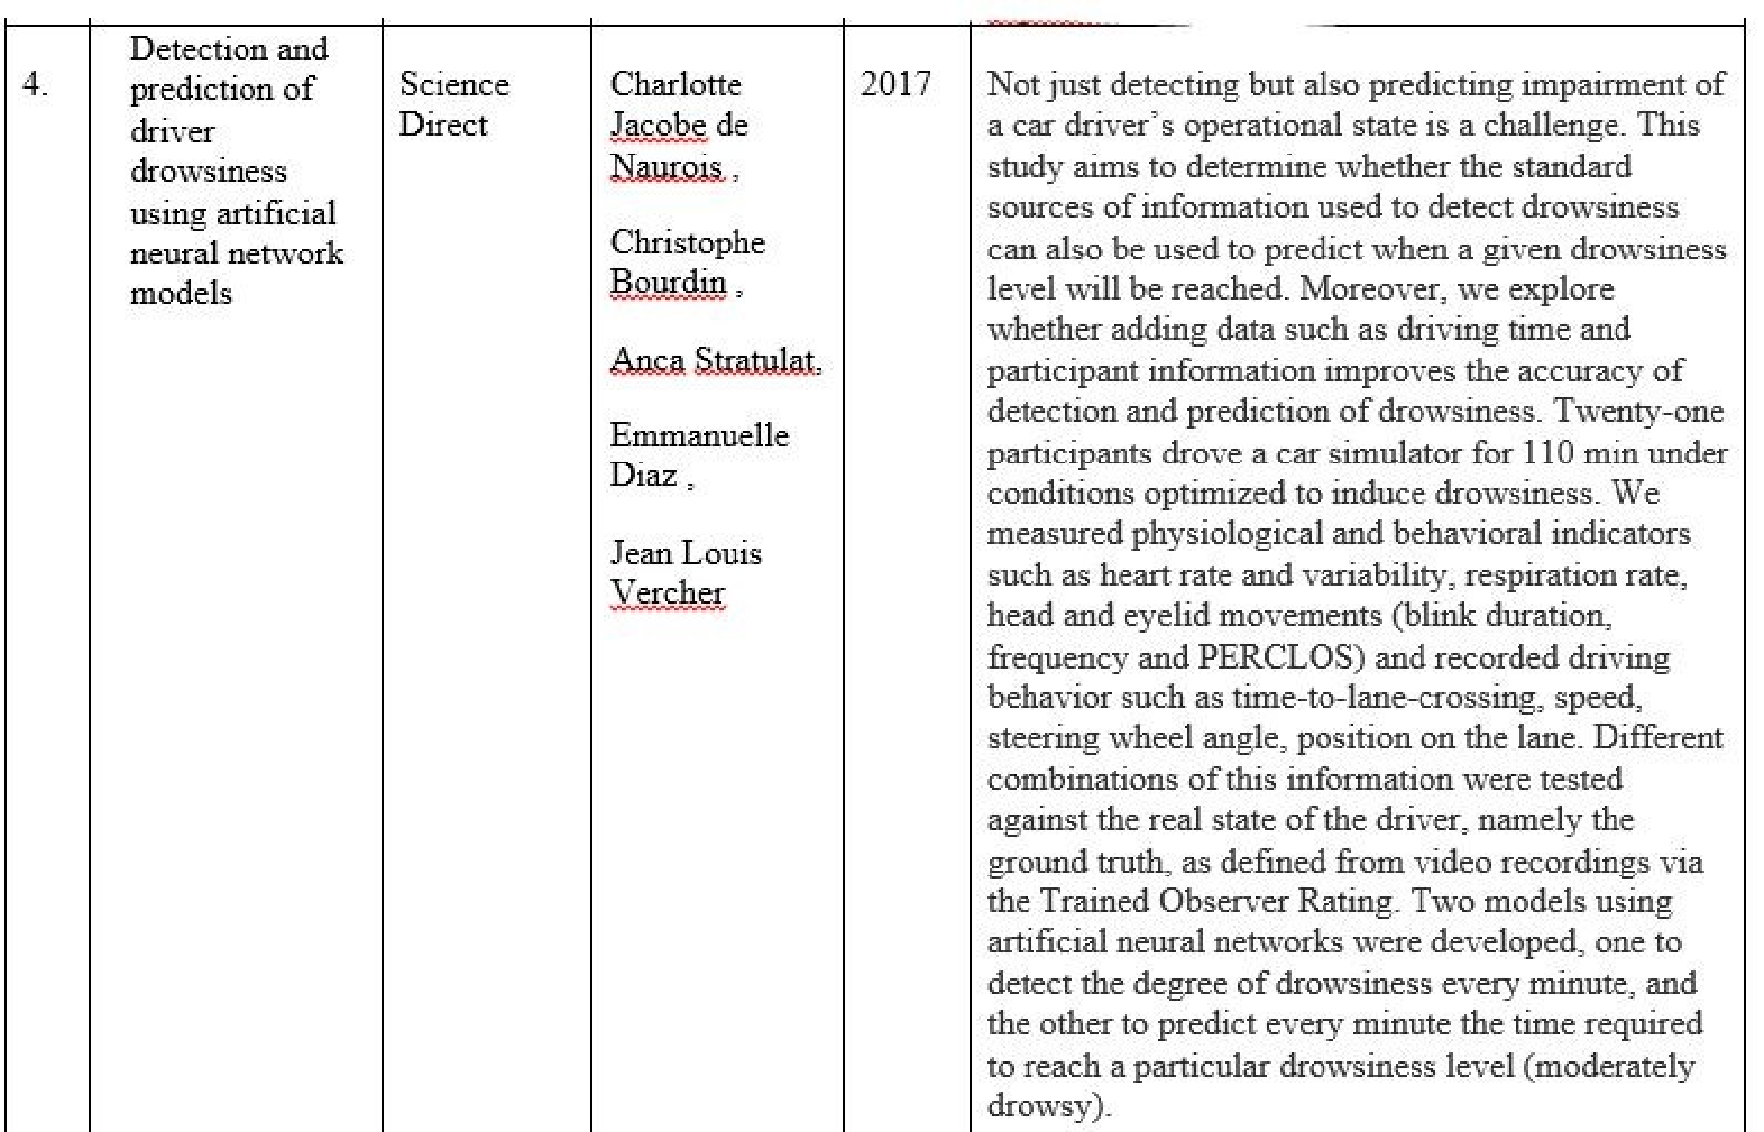

Slide 9
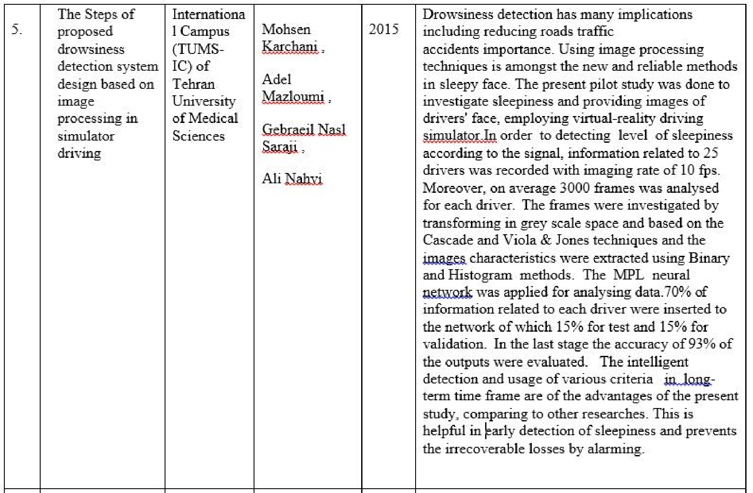

Slide 10

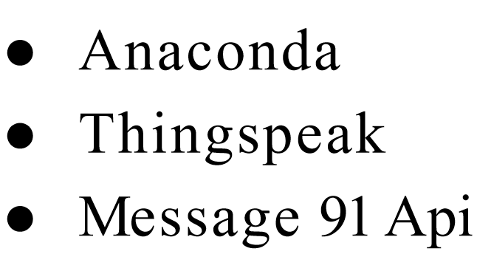
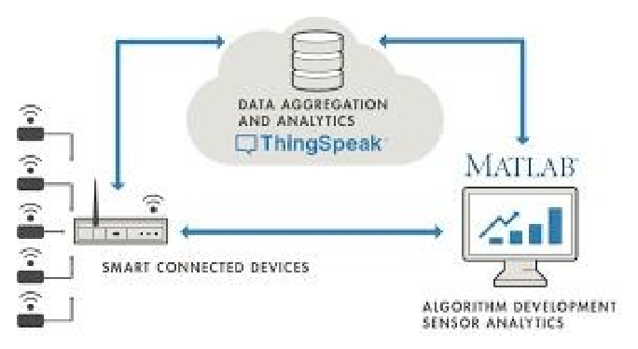
SOFTWARE USED

Slide 11
LIBRARIES USED
Scipy : to get the mathematical analysis of the data
Imutils : accessing the webcam
Playsound : for activating the alarm
Dlib: for face detection database
Opencv : analysis of the video stream

Slide 12
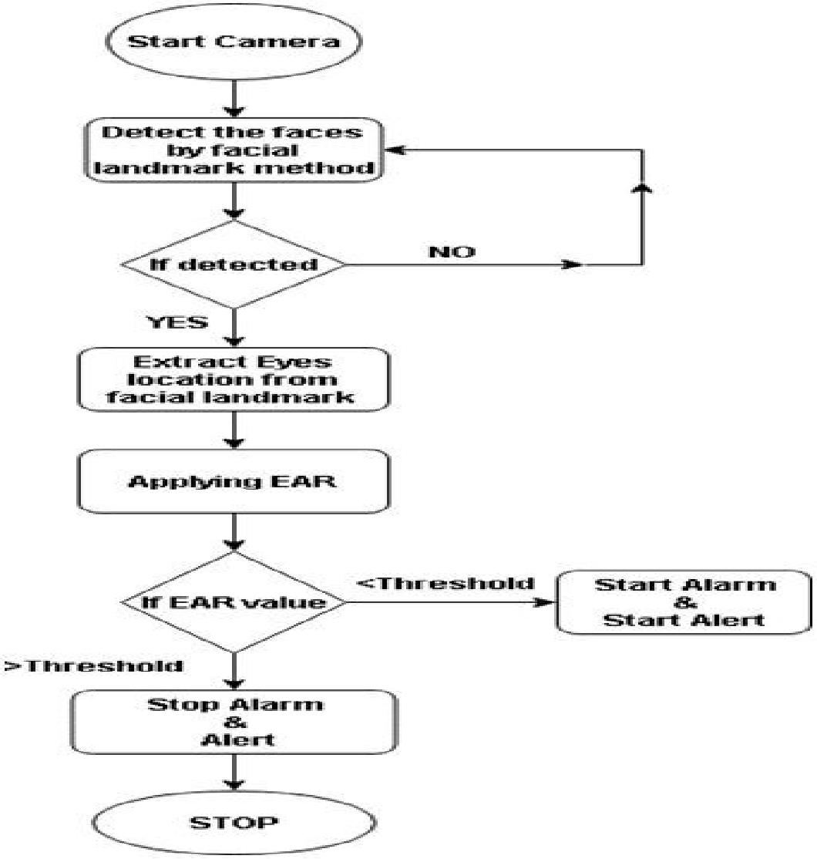
METHODOLOGY

Slide 13
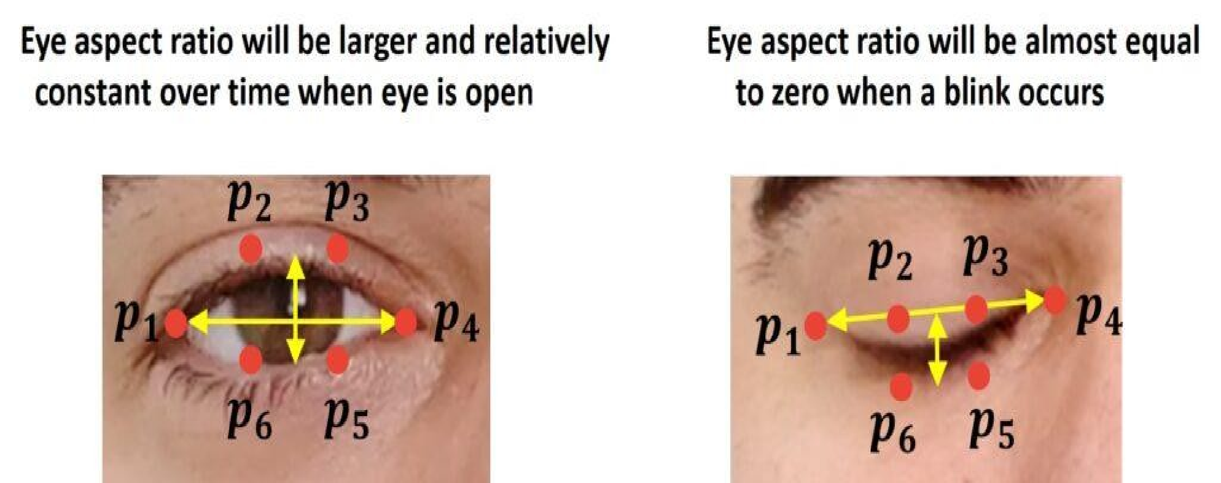
EYE ASPECT RATIO

Slide 14
TRADES OFF
While developing the system, we found that due to the light intensity of the video captured there is possibility of glare for the users with spectacles.
It is not possible for us to suggest the customer to use a particular type of spectacles for our system to work, so this is one major trade-off we have made.

Slide 15
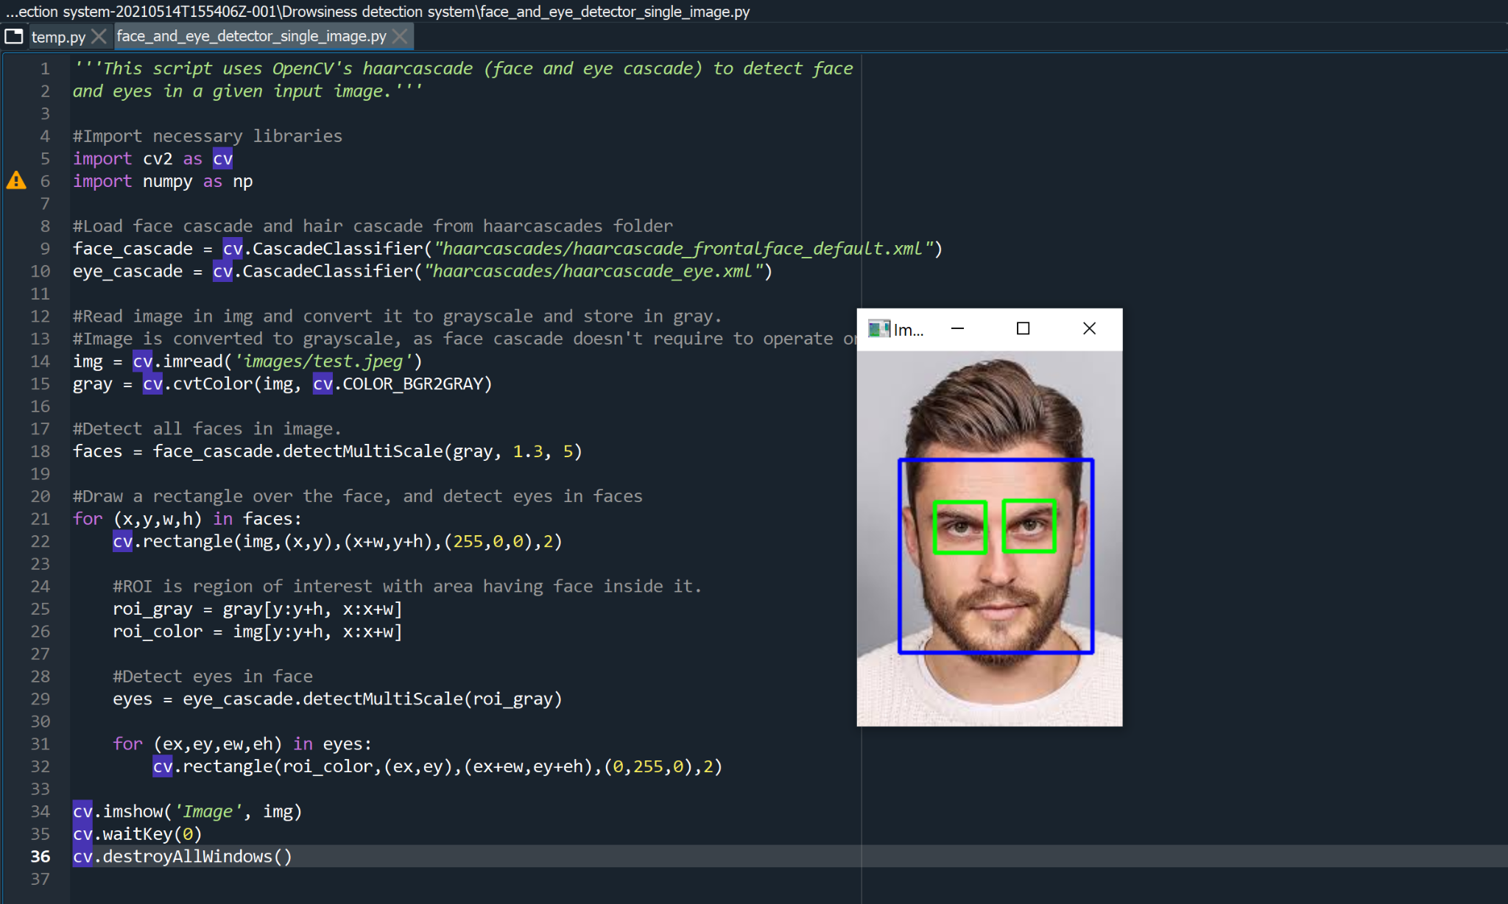
RESULTS:

Slide 16
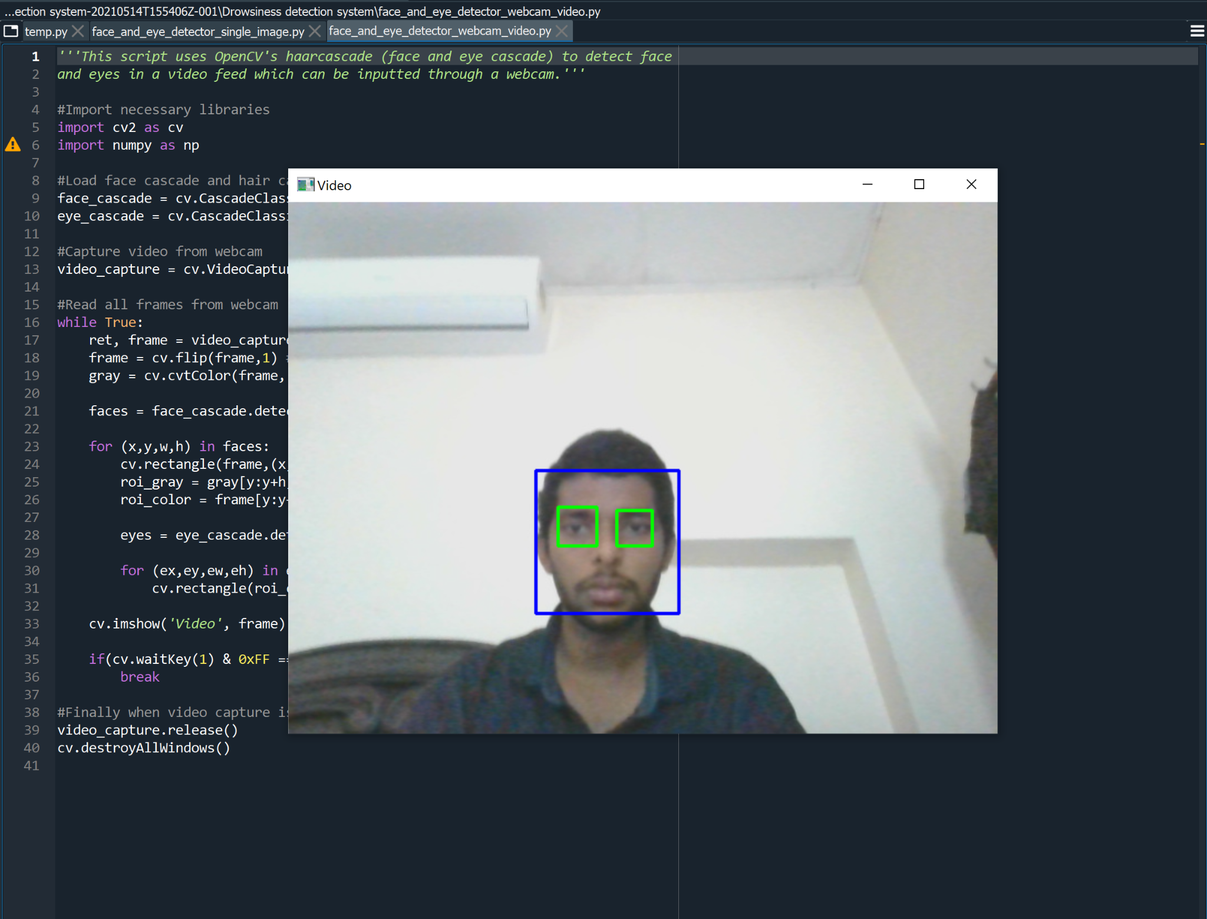

Slide 17
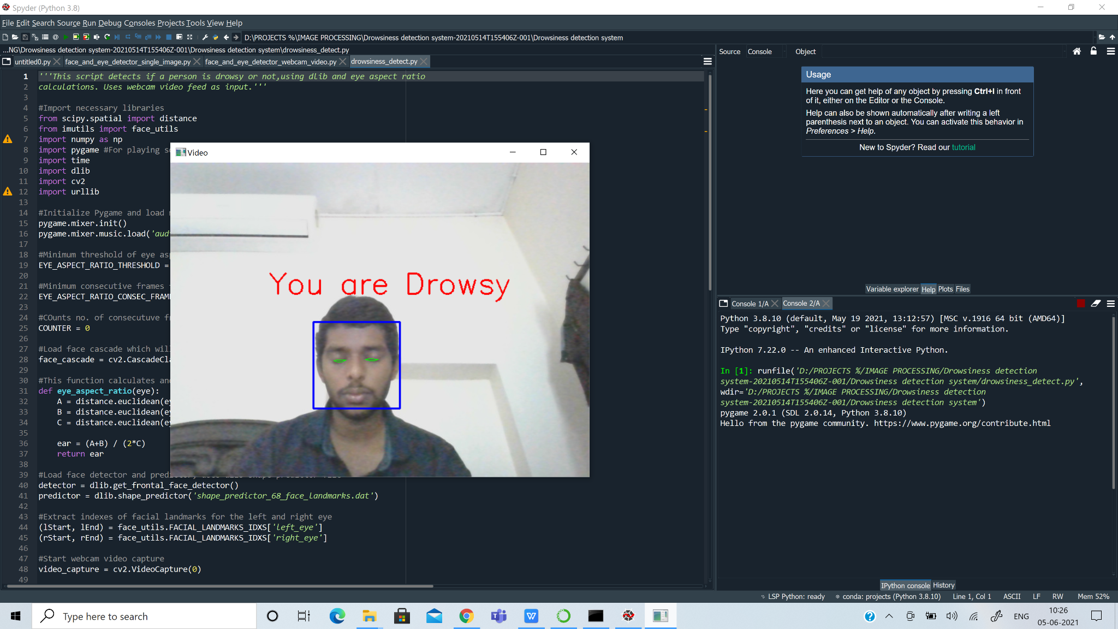

Slide 18
PROBLEMS FACED
The system developed is a completely research based system and thus not a lot of information is available about the standard thresholds to be taken into consideration
Due to this issue, we had to take a threshold value on our own.
Threshold for the number frames to be considered depends majorly on the processing speed of each computer for now and later on the speed of the processor.
When it comes to setting a threshold for EAR we had to run and check for ourselves what was best. It had to be changed to a lower value due to the variable eye size.

Slide 19
CONCLUSION
This task speaks to a case of methodical way to deal with the appraisal of wearable sensors for physiological parameter estimation. By this undertaking driver's laziness is checked persistently. In a bad position, they will be frightened and display effortlessly. In order to keep away from street mishaps outlining driver sluggishness location framework will be absolutely productive. In this way it is presumed that eye checking framework is one of the quick technique for inﬂuencing driver to alarm if sluggishness orehaustion is experienced while driving.. The framework utilizes a blend of layout based coordinating so as to restrict the eyes. Amid following, framework will have the capacity to choose if the eyes are open or shut and whether the driver is looking in front. At the point when the eye will be shut for a really long time, a notice ﬂag will be given as bell or caution pack message.

Slide 20
REFERENCES
A Rosebrock. (2017, Apr. 3). Facial landmarks with dlib, OpenCV, and Python [Online]. Available
T. Soukupova and J. Cech. (2016, Feb. 3) Real-Time Eye Blink Detection using Facial Landmarks:
V. Kazemi and J. Sullivan. (2014) One Millisecond Face Alignment

